Slide 1


California Approves First New U.S. Thermal Solar Plant
California regulators on Wednesday approved a license for the nation’s first large-scale solar thermal power plant in two decades.
The licensing of the 250-megawatt Beacon Solar Energy Project after a two-and-a-half-year environmental review comes as several other big solar farms are set to receive approval from the California Energy Commission in the next month.
“I hope this is the first of many more large-scale solar projects we will permit,” said Jeffrey D. Byron, a member of the California Energy Commission, at a hearing in Sacramento on Wednesday. “This is exactly the type of project we want to see.”
Developers and regulators have been racing to license solar power plants and begin construction
before the end of the year, when federal incentives for such renewable energy projects expire. California’s three investor-owned utilities also face a deadline to obtain 20 percent of their electricity from renewable sources by the end of 2010.
Still, it has been long slog as solar power plants planned for the Mojave Desert have become bogged down in disputes over their impact on protected wildlife and scarce water supplies.
In March 2008, NextEra Energy Resources filed an application to build the Beacon project on 2,012 acres of former farmland in Kern County. Long rows of mirrored parabolic troughs will focus sunlight on liquid-filled tubes to create steam that drives an electricity-generating turbine. Some rural residents immediately objected to the 521 million gallons of groundwater the project would consume annually in an arid region on the western edge of the Mojave
Desert. After contentious negotiations with regulators, NextEra agreed to use recycled water that will be piped in from a neighboring community.

Slide 2
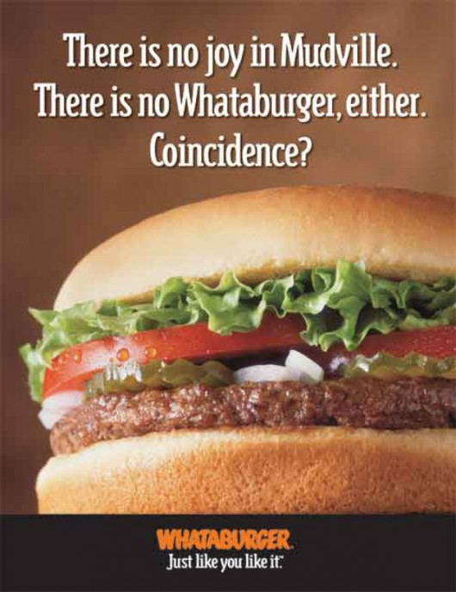

Why Getting Old Means Drinking Less
If you feel like you can’t drink the way you used to, you’re not alone. An aging body is more sensitive to alcohol than a younger one.
The National Institutes of Health’s Senior Health web site today issued new warnings about alcohol and aging, reminding people 65 and older that even a few drinks can hit them harder than in their youth.
The reason is that older people metabolize alcohol more slowly, and they also have less water in their bodies. The result is that an adult who consumes just a few glasses of wine will have a higher percentage of alcohol in his or her blood than a younger person drinking the same thing. That’s why you may start feeling tipsy
sooner after consuming alcohol, even if your drinking habits are the same as always.
Alcohol also can make certain age-related health problems worse, like high blood pressure, diabetes, liver ailments and memory problems, among others. And because older people typically take more medications, they have an increased risk of an alcohol-drug interaction, which can cause confusion, instability while walking, nausea or other problems.
For instance, drinking alcohol while taking medications for high blood pressure, diabetes, gout or heart failure can make those conditions worse. Even over-the-counter pain relievers can pose a risk. Drinking alcohol while using aspirin or arthritis drugs can increase the risk for stomach bleeding. Alcohol can also increase the risk for liver damage if taken with acetaminophen, the pain reliever in Tylenol.
Alcohol can also lead to balance problems. Older adults who drink are at higher risk for hip fractures.

Slide 3


A New Risk Factor: Your Social Life
Social relationships are just as important to health as other common risk factors like smoking, lack of exercise or obesity, new research shows.
Numerous studies have suggested that strong social ties are associated with better health and longevity, but now a sweeping review of the research shows just how important social relationships really are. Researchers from Brigham Young University reviewed 148 studies that tracked the social habits of more than 300,000 people. They found that people who have strong ties to family, friends or co-workers have a 50 percent lower risk of dying over a given period than those with fewer social connections, according to the journal Plos Medicine.
The researchers concluded that having few friends or weak social ties to the community is just as
harmful to health as being an alcoholic or smoking nearly a pack of cigarettes a day.
Weak social ties are more harmful than not exercising and twice as risky as being obese, the researchers found.
Notably, the strongest effect was shown when studies used complex measures of social integration, focusing on a person’s family ties, friendships and work connections. In those studies, the survival rates for people with strong relationships were twice that of those with weaker ties. Single measures, like whether a person was married or living alone, weren’t good predictors of health. For instance, people who lived with others had just a 19 percent survival benefit compared with those who lived alone.
_x0016_ Although research has long suggested social relationships are linked with better health, it
_x0018__x0018_hasn’t been clear whether the effect is due to the fact that healthy people are more likely to be socially active. A person with chronic health problems has more difficulty spending time at work and with friends.

Slide 4


Black Holes
According to the general theory of relativity, a black hole is a region of space from which nothing, not even light, can escape.It is the result of the deformation of space-time caused by a very compact mass.
Around a black hole there is an undetectable surface which marks the point of no return, called an event horizon. It is called "black" because it absorbs all the light that hits it, reflecting nothing, just like a perfect black body in thermodynamics.
Under the theory of quantum mechanics, black holes possess a temperature and emit Hawking radiation, but for black holes of stellar mass or larger this temperature is much lower than that of the cosmic background radiation.
Despite its invisible interior, a black hole can be observed through its interaction with other matter.
A black hole can be inferred by tracking the movement of a group of stars that orbit a region in space. Alternatively, when gas falls into a stellar black hole from a companion star, the gas spirals inward, heating to very high temperatures and emitting large amounts of radiation that can be detected from earthbound and Earth-orbiting telescopes.
Once a black hole has formed, it can continue to grow by absorbing additional matter. Any black hole will continually absorb gas and interstellar dust from its direct surroundings and omnipresent cosmic background radiation. This is the primary process through which supermassive black holes seem to have grown.
The term "black hole" was first publicly used by John Wheeler during a lecture in 1967.
Although he is usually credited with coining the phrase, he always insisted that it was suggested to him by somebody else. After Wheeler's use of the term, it was quickly adopted in general use.

Slide 5


The North American Black Bear
The American black bear (Ursus americanus) is North America's smallest and most common species of bear.
Black bears are omnivores, with their diets varying greatly depending on the season. Black bears typically live in largely forested areas, but do leave forests in search of food. Sometimes they become attracted to human communities because of the immediate availability of food.
The American black bear is listed by the IUCN as Least Concern, due to the species' widespread distribution and a large global population estimated to be twice that of all other bear species combined.
The skulls of American black bears are broad, with narrow muzzles and large jaw hinges. Females tend
to have more slender and pointed faces than males.
Their claws are typically black or grayish brown. The claws are short and rounded, being thick at the base and tapering to a point. Claws from both hind and front legs are almost identical in length, though the foreclaws tend to be more sharply curved.
The American black bear tail is usually 4.8 inches long. The ears are small and rounded, and are set well back on the head. The soles of the feet are black or brownish, and are naked, leathery and deeply wrinkled.
Black bears are highly dexterous, being capable of opening screw-top jars and manipulating
door latches. They also have great physical strength, having been known to turn over flat-shaped rocks weighing 310 to 325 pounds by flipping them over with a single foreleg.

Slide 6


Penguins
Penguins are a group of aquatic, flightless birds living almost exclusively in the southern hemisphere, especially in Antarctica.
Highly adapted for life in the water, penguins have counter shaded dark and white plumage, and their wings have become flippers. Most penguins feed on krill, fish, squid, and other forms of sealife caught while swimming underwater. They spend about half of their life on land and half in the oceans.
Although all penguin species are native to the southern hemisphere, they are not found only in cold climates, such as Antarctica. In fact, only a few species of penguin live so far south. Several species are found in the temperate zone, and one species, the Galápagos Penguin, lives near the equator.
The largest living species is the Emperor Penguin: adults average about 1.1 m tall and weigh 35 kg.
or more. The smallest penguin species is the Little Blue Penguin, also known as the Fairy Penguin, which stands around 40 cm tall and weighs 1 kg.
Among extant penguins, larger penguins inhabit colder regions, while smaller penguins are generally found in temperate or even tropical climates. Some prehistoric species attained enormous sizes, becoming as tall or as heavy as an adult human. These were not restricted to Antarctic regions; on the contrary, subantarctic regions harbored high diversity, and at least one giant penguin occurred in a region not quite 2,000 km south of the equator 35 mya, in a climate decidedly warmer than today.
Penguins are superbly adapted to aquatic life. Their vestigial wings have become flippers, useless for flight in the air. In the water, however, penguins are astonishingly agile.

Slide 7

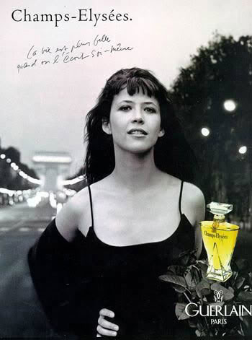
Nebulae
A nebula is an interstellar cloud of dust, hydrogen gas, helium gas and other ionized gases. Originally nebula was a general name for any extended astronomical object, including galaxies beyond the Milky.
Nebulae often form star-forming regions, such as in the Eagle Nebula. In regions the formations of gas, dust and other materials "clump" together to form larger masses, which attract further matter, and eventually will become big enough to form stars. The remaining materials are then believed to form planets, and other planetary system objects.
Many nebulae or stars form from the gravitational collapse of gas in the interstellar
medium. As the material collapses under its own weight, massive stars may form in the center, and
their ultraviolet radiation ionizes the surrounding gas, making it visible at optical wavelengths. Examples of these types of nebulae are the Rosette Nebula and the Pelican Nebula. The size of these nebulae, known as HII regions, varies depending on the size of the original cloud of gas. These are sites where star formation occurs. The formed stars are sometimes known as a young, loose cluster.
Some nebulae are formed as the result of supernova explosions, the death throes of massive, short-lived stars. The materials thrown off from the supernova explosion are ionized by the energy and the compact object that it can produce. One of the best examples of this is the Crab Nebula, in Taurus. The supernova event was recorded in the year 1054 and is labelled SN 1054. The compact object that was created after the
explosion lies in the center of the Crab Nebula and is a neutron star.

Slide 8

The Leaning Tower of Pisa
Construction of the tower took part in three stages over a period of about a hundred and seventy-seven years. Work on the first floor of the white marble campanile began in the tenth century, during a period of military success and prosperity.
The tower began to sink after construction had progressed to the third floor three years
after construction had started. This was due to a mere three meter foundation, set in weak, unstable subsoil, a design that was flawed from the beginning. Construction was subsequently halted for almost a century.

Slide 9


Colossus of Rhodes
The Colossus of Rhodes was a statue of the Greek god Helios, erected in the city of Rhodes on the Greek island of Rhodes by Chares of Lindos between 292 and 280 BC. It is considered one of the Seven Wonders of the Ancient World. Before its destruction, the Colossus of
Rhodes stood over thirty meters high, making it one of the tallest statues of the
ancient world.
Alexander the Great died at the early age of thirty-two in 323 BC without having had time to put into place any plans for his succession. Fighting broke out among his generals.

Slide 10
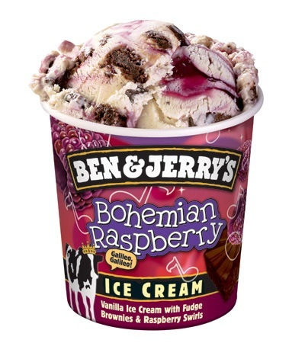

The Dead Sea: Natural History
There are two contending hypotheses about the origin of the low elevation of the Dead Sea. The older hypothesis is that it lies in a true rift zone, an extension of the Red Sea Rift, or even of the Great Rift Valley of eastern Africa. A more recent hypothesis is that the Dead Sea basin is a
consequence of a "step-over" discontinuity along the Dead Sea. Transform, creating
extension of the crust with consequent subsidence.
Around three million years ago, what is now the valley of the Jordan River, Dead Sea, and Wadi Arabah was repeatedly inundated by waters from the Mediterranean Sea.

